Slide 1
Voter Information Session
County County
Legislative District(s): 00
Congressional District(s): 00

Slide 2
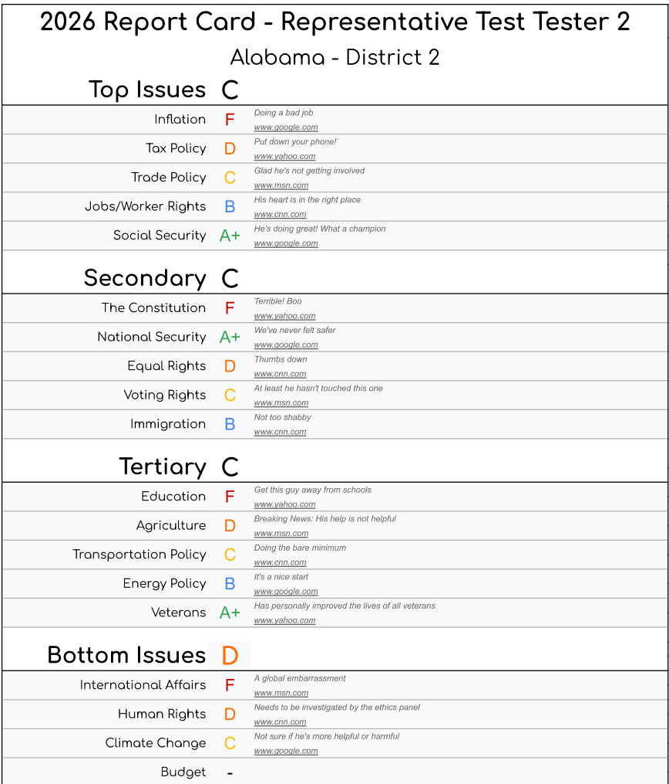
Why are we meeting today?
To review the records of our current elected officials and to submit grades based on their performance to RateMyRep.blog
This exercise will help us become more knowledgeable about our district and the grades we submit will be published online for others to see and share (see example report card on the right)
We will talk about other ways you can get involved with the upcoming election

Slide 3


Slide 4
Incumbents Reviewed in this Session
National Official Name – Title – District – Tenure Start Date
State Official Name – Title – District (if applicable) – Tenure Start Date
County Official Name – Title – County – Tenure Start Date
City Official Name – Title – City – Tenure Start Date
Local Official Name – Title – District – Tenure Start Date

Slide 5

[Elected Official Name] – [Title]
The Economy
Scan for blank report card
Local/State/National Budget
  Official action 1 (Press release, presentation, vote, action, meeting, etc) – Date – Source
  Official action 2 – Date – Source
  Official action 3 – Date – Source
Inflation
  Official action 1 (Press release, presentation, vote, action, meeting, etc) – Date – Source
  Official action 2 – Date – Source
  Official action 3 – Date – Source
Tax Policy
  Official action 1 (Press release, presentation, vote, action, meeting, etc) – Date – Source
  Official action 2 – Date – Source
  Official action 3 – Date – Source
Trade Policy
  Official action 1 (Press release, presentation, vote, action, meeting, etc) – Date – Source
  Official action 2 – Date – Source
  Official action 3 – Date – Source
Report Card Grading Rubric
Has acted in a way that harms the issue
Indirectly harmed or neglected duty on issue
Has not had a meaningful impact on issue
Initiated action or made procedural moves
Initiated action or made procedural moves

Slide 6
[Official Name] – [Title] – [District]
Social Infrastructure
Scan for blank report card
Jobs/Worker Rights
  Official action 1 (Press release, presentation, vote, action, meeting, etc) – Date – Source
  Official action 2 – Date – Source
  Official action 3 – Date – Source
Social Security (skip where not applicable)
  Official action 1 (Press release, presentation, vote, action, meeting, etc) – Date – Source
  Official action 2 – Date – Source
  Official action 3 – Date – Source
Education
  Official action 1 (Press release, presentation, vote, action, meeting, etc) – Date – Source
  Official action 2 – Date – Source
  Official action 3 – Date – Source
Veterans
  Official action 1 (Press release, presentation, vote, action, meeting, etc) – Date – Source
  Official action 2 – Date – Source
  Official action 3 – Date – Source
Equality
  Official action 1 (Press release, presentation, vote, action, meeting, etc) – Date – Source
  Official action 2 – Date – Source
  Official action 3 – Date – Source
Report Card Grading Rubric
Has acted in a way that harms the issue
Indirectly harmed or neglected duty on issue
Has not had a meaningful impact on issue
Initiated action or made procedural moves
Initiated action or made procedural moves

Slide 7
[Official Name] – [Title] – [District]
Law & Security
Scan for blank report card
The Constitution
  Official action 1 (Press release, presentation, vote, action, meeting, etc) – Date – Source
  Official action 2 – Date – Source
  Official action 3 – Date – Source
Voting Rights
  Official action 1 (Press release, presentation, vote, action, meeting, etc) – Date – Source
  Official action 2 – Date – Source
  Official action 3 – Date – Source
Immigration
  Official action 1 (Press release, presentation, vote, action, meeting, etc) – Date – Source
  Official action 2 – Date – Source
  Official action 3 – Date – Source
Local/State/National Security
  Official action 1 (Press release, presentation, vote, action, meeting, etc) – Date – Source
  Official action 2 – Date – Source
  Official action 3 – Date – Source
Report Card Grading Rubric
Has acted in a way that harms the issue
Indirectly harmed or neglected duty on issue
Has not had a meaningful impact on issue
Initiated action or made procedural moves
Initiated action or made procedural moves

Slide 8
[Official Name] – [Title] – [District]
Physical Infrastructure
Scan for blank report card
Agriculture
  Official action 1 (Press release, presentation, vote, action, meeting, etc) – Date – Source
  Official action 2 – Date – Source
  Official action 3 – Date – Source
Transportation
  Official action 1 (Press release, presentation, vote, action, meeting, etc) – Date – Source
  Official action 2 – Date – Source
  Official action 3 – Date – Source
Energy Policy
  Official action 1 (Press release, presentation, vote, action, meeting, etc) – Date – Source
  Official action 2 – Date – Source
  Official action 3 – Date – Source
Report Card Grading Rubric
Has acted in a way that harms the issue
Indirectly harmed or neglected duty on issue
Has not had a meaningful impact on issue
Initiated action or made procedural moves
Initiated action or made procedural moves

Slide 9
[Official Name] – [Title] – [District]
Global Issues
Scan for blank report card
International Affairs (skip where not applicable)
  Official action 1 (Press release, presentation, vote, action, meeting, etc) – Date – Source
  Official action 2 – Date – Source
  Official action 3 – Date – Source
Human Rights (skip where not applicable)
  Official action 1 (Press release, presentation, vote, action, meeting, etc) – Date – Source
  Official action 2 – Date – Source
  Official action 3 – Date – Source
Environment
  Official action 1 (Press release, presentation, vote, action, meeting, etc) – Date – Source
  Official action 2 – Date – Source
  Official action 3 – Date – Source
Report Card Grading Rubric
Has acted in a way that harms the issue
Indirectly harmed or neglected duty on issue
Has not had a meaningful impact on issue
Initiated action or made procedural moves
Initiated action or made procedural moves

Slide 10
[Official Name] – [Title] – [District]
Group Discussion
Scan for blank report card
The Economy
  Budget – Use this page to take notes on what the group brings up during the meeting
  Inflation
  Taxes
  Trade
Social Infrastructure
  Jobs/Worker Rights
  Social Security
  Education
  Veterans
  Equality
Law & Security
  The Constitution
  Voting Rights
  Immigration
  Security
Physical Infrastructure
  Agriculture
  Transportation
  Energy
Global Issues
  International Affairs
  Human Rights
  Environment
Report Card Grading Rubric
Has acted in a way that harms the issue
Indirectly harmed or neglected duty on issue
Has not had a meaningful impact on issue
Initiated action or made procedural moves
Initiated action or made procedural moves

Slide 11
[Title] – [District]
Election Challengers
Primary Challenger Name
  Highlight 1 (optional)
  Highlight 2 (optional)
Primary Challenger Name
  Highlight 1 (optional)
  Highlight 2 (optional)
Other Party Challenger 1
  Highlight 1 (optional)
  Highlight 2 (optional)
Other Party Challenger 2
  Highlight 1 (optional)
  Highlight 2 (optional)
Other Party Challenger 3
  Highlight 1 (optional)
  Highlight 2 (optional)

Slide 12
10 minute break

